Slide 1
Project Management
Soroor Aghamiri, Zeinab Sadeghian, Hesam Hashemizadeh, Sepideh Yazdi

Slide 2
Outline
What Is a Project?
Project Phase
Project Life Cycle
Product Life Cycles
Product life cycles vs Products life cycles
What Helps Projects Succeed?
What is Project Management?
Important Skills for Project Managers

Slide 3
What Is a Project?
A project is:
a temporary endeavor to create a unique
product
service
result
End when:
their objectives have been reached
the project has been terminated

Slide 4
Project Phase
Project phases vary by project or industry, but some general phases include :
Concept
Development
Implementation
Close-out

Slide 5
Project Life Cycle
A project life cycle is a collection of project phases that defines :
What work
What deliverables and when
Who is involved
How management will control and approve work

Slide 6
Products life cycles
The Systems Development Life Cycle (SDLC) is a framework for describing the phases involved in developing and maintaining information systems

Slide 7
Product life cycles vs Products life cycles
The project life cycle applies to all projects, regardless of the products being produced
Product life cycle models vary considerably based on the nature of the product
Project management is done in all of the product life cycle phases

Slide 8
Product life cycles vs Products life cycles
Define Project Goals
Plan Project
Execute Project
Close Project
Evaluate Project
Planning
Analysis
Design
Implementation
Testing
The Systems Development Life Cycle (SDLC)

Slide 9
What Helps Projects Succeed?
Experienced project manager
Proper planning
Reliable estimates
Clear business objectives
Minimized scope
Executive support
User involvement
Formal methodology
Firm basic requirements
Competent staff

Slide 10
What is Project Management?
Project management is :
the application of knowledge
skills
tools
techniques
to project activities
to meet project requirements

Slide 11
Project Manager
project managers are
Organized
Passionate
Goal-oriented
individuals who drive business results by leading projects

Slide 12
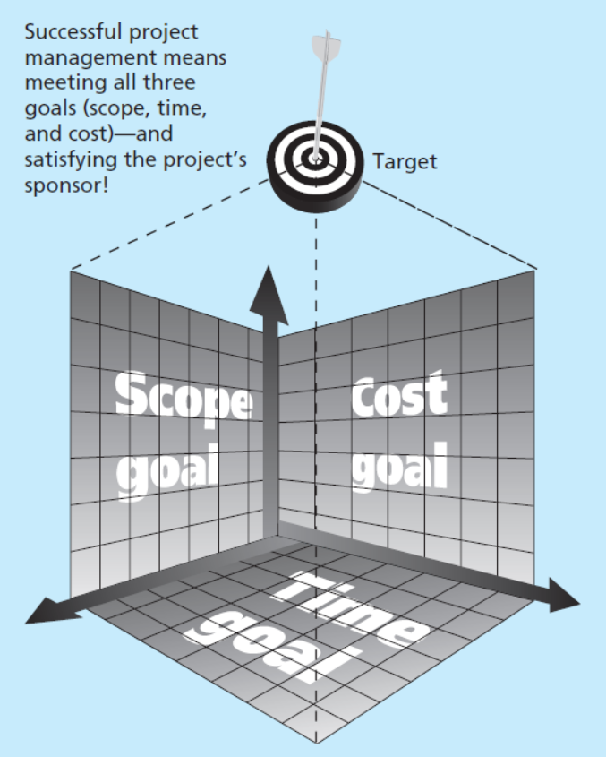
What is Project Management?
Project managers strive to meet the triple constraint by balancing these goals:
project scope
time
cost

Slide 13
Important Skills for Project Managers
Ethical behavior
People skills
Strong at building trust
Strong at building teams
Leadership
Verbal communication
Listening
Conflict resolution, conflict management
Critical thinking, problem solving
Understands, balances priorities

Slide 14
Thank you!
Questions?

